Slide 1
Earthquake Prediction Model with Machine Learning
ML Team Gamma

Slide 2
INTRODUCTION

Slide 3

Earthquake Prediction Using Machine Learning
Earthquakes are catastrophic events that cause severe damage and loss of life. Predicting them accurately is challenging due to their complexity. This project explores using machine learning to develop a model for earthquake prediction, leveraging seismic records, geological data, and environmental factors to enhance accuracy and mitigate impacts.

Slide 4
OBJECTIVES

Slide 5
Objectives
Data Collection: Acquire and preprocess seismic activity, geological, and environmental data.
Exploratory Data Analysis (EDA): Identify patterns and correlations using visualizations and statistical analysis.
Model Development: Build and train machine learning models for earthquake prediction.
Model Evaluation: Assess model performance with relevant metrics and validate predictive accuracy.
Deployment: Develop a user-friendly interface or dashboard for visualizing and interacting with predictions.

Slide 6
PROCESS FOR MAKING THE EARTHQUAKE PREDICTION MODEL USING ML
Data Collection
Data Preprocessing
Exploratory Data Analysis (EDA)
Model Selection
Model Training
Model Evaluation
Model Comparison and Selection
Deployment and Integration

Slide 7
01
DATA COLLECTION

Slide 8
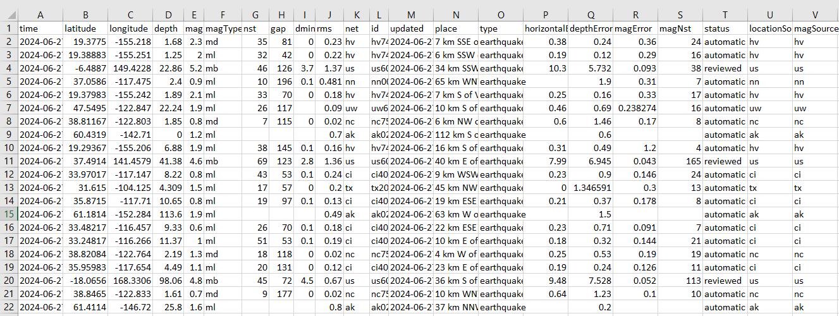
Data Collection
Acquired recent earthquake data from the United States Geological Survey (USGS) Earthquake Hazards Program.
Utilized Python's pandas library to import and organize the data into a structured DataFrame.
The dataset includes detailed information such as earthquake magnitude, location, depth, and occurrence time for events recorded within the past month.

Slide 9
02
DATA PRE-PROCESSING

Slide 10

Data Pre-Processing Steps
Filtered Relevant Columns: Retained only essential columns such as latitude, longitude, depth, and magnitude.
Handled Missing Values: Identified and removed rows with missing data to ensure data integrity.
Standardized Numerical Features: Standardized numerical features to have zero mean and unit variance, improving model performance.
Split the Data: Divided the dataset into training (80%) and testing (20%) sets to evaluate model performance accurately.

Slide 11
03
EDA

Slide 12
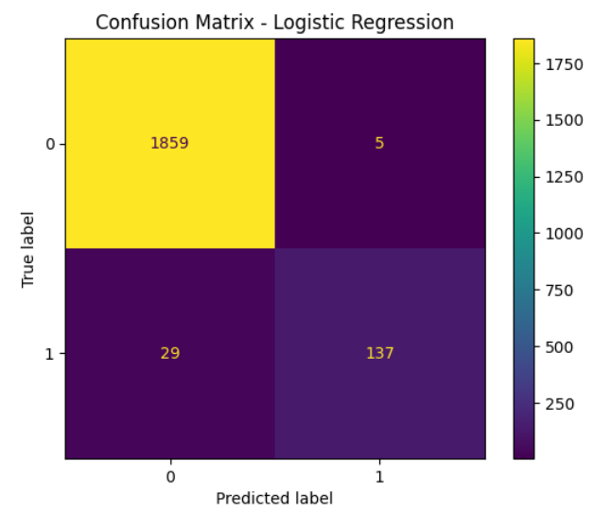
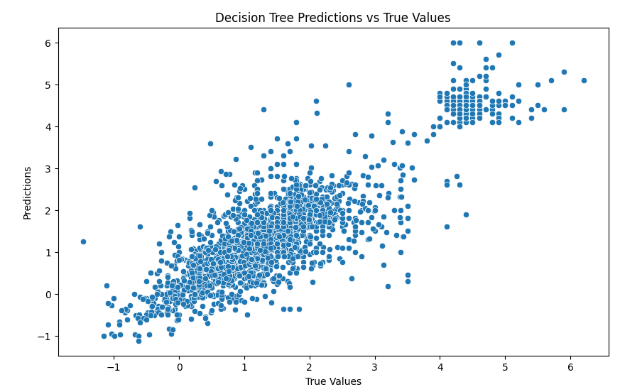
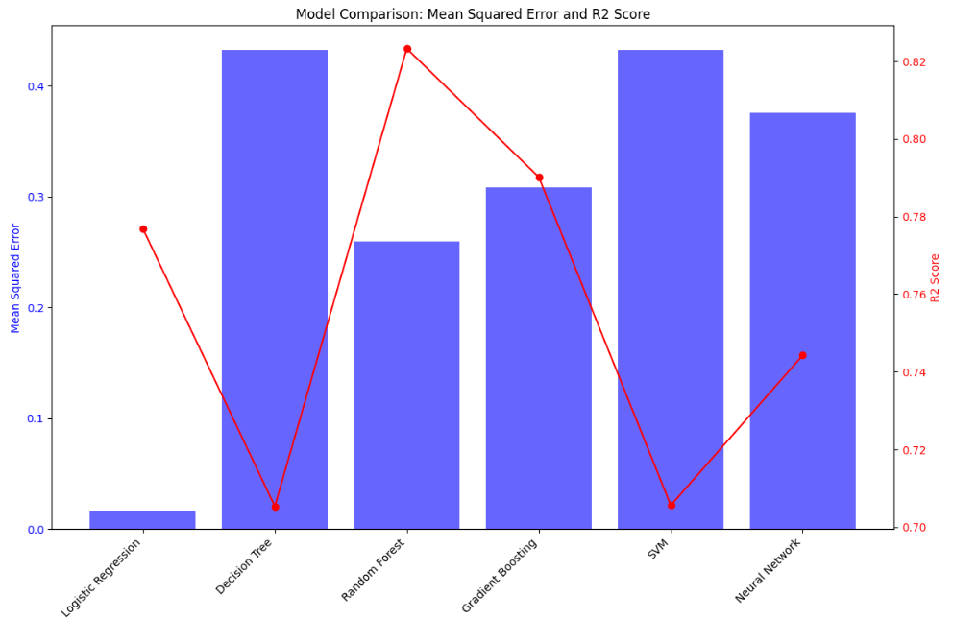
Exploratory Data Analysis
Libraries:
Matplotlib & Seaborn
Key Visualizations:
Confusion Matrix: Assesses classification accuracy.
Scatter Plot: Compares model predictions to actual values.
Bar Plot with Line Plot: Evaluates model performance (MSE, R2 Score).

Slide 13
04
MODEL TRAINING & EVALUATION

Slide 14

Logistic Regression
Objective: Classify earthquakes into two categories: < 4.0 and ≥ 4.0 magnitude.
Approach:
Simplified binary classification problem.
Model chosen for simplicity, interpretability, and efficiency.
Trained on standardized data.
Performance Metrics:
Evaluated using Mean Squared Error (MSE) and R² score.
Confusion matrix visualized classification results.

Slide 15

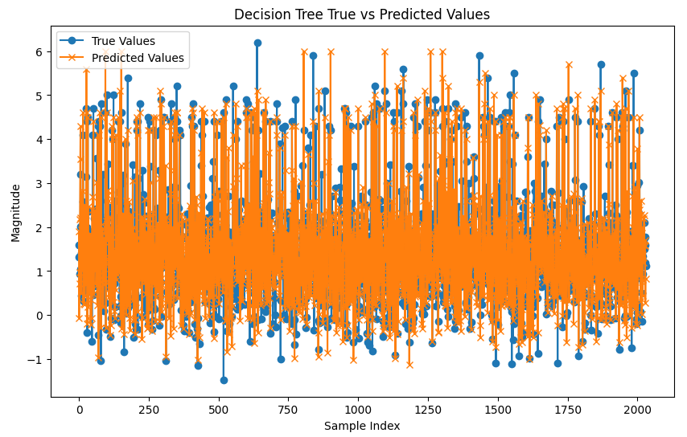
Decision Tree
Objective: Predict continuous earthquake magnitudes.
Model Choice:
Selected for simplicity and interpretability.
Captures non-linear relationships and handles numerical/categorical features.
Training: Learned from standardized data.
Evaluation Metrics:
Mean Squared Error (MSE) for prediction error.
R² score for goodness of fit.
Outcome: Provided a baseline for the model's capability in predicting earthquake magnitudes.

Slide 16
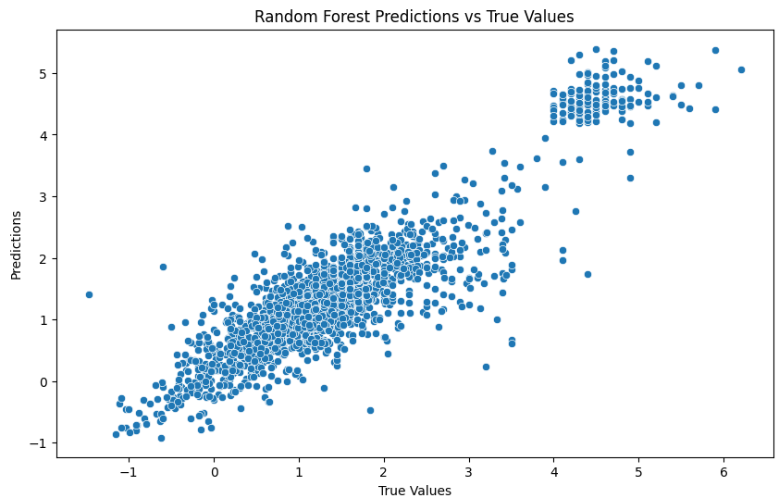
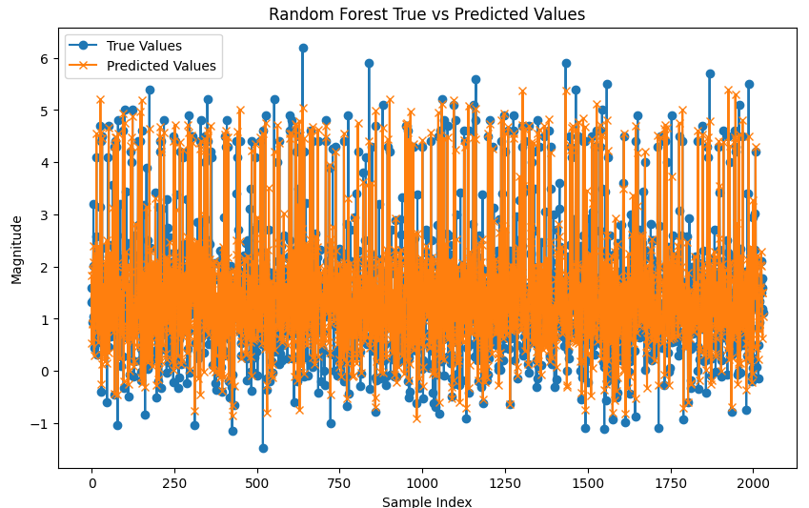
Random Forest
Objective: Enhance prediction accuracy and control over fitting.
Model Choice:
Ensemble method combining multiple decision trees.
Trained on random data subsets to reduce variance.
Suitable for large datasets and complex feature interactions.
Training: Learned from standardized data.
Evaluation Metrics:
Mean Squared Error (MSE) for prediction error.
R² score for goodness of fit.
Outcome: Improved accuracy, robustness, and reliability of predictions.

Slide 17
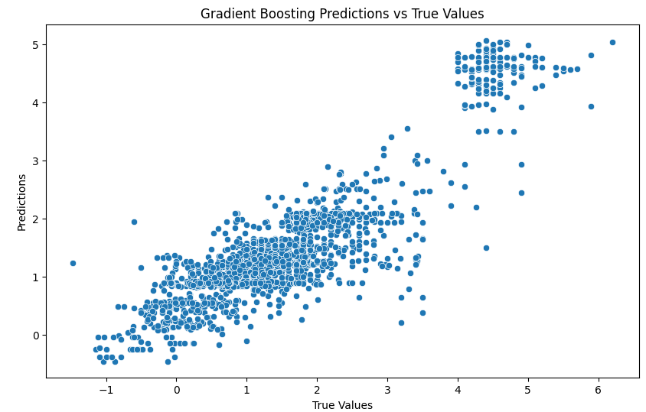
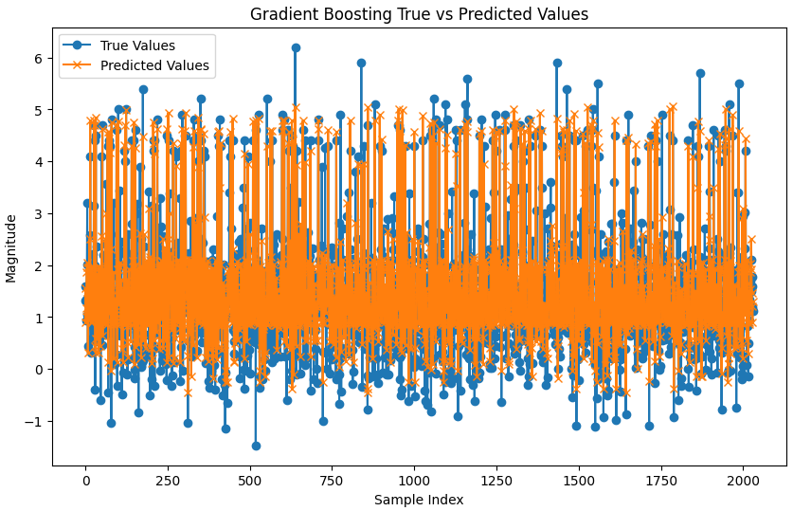
Gradient Boosting
Objective: Minimize prediction errors and improve accuracy.
Approach: Sequentially builds models to correct previous errors.
Training: Iterative process on standardized data.
Strengths:
Effective for imbalanced datasets.
Boosts weak learners to enhance performance.
Metrics: Mean Squared Error (MSE) and R² score.
Outcome: Improved efficiency and accuracy in predicting earthquake magnitudes.

Slide 18
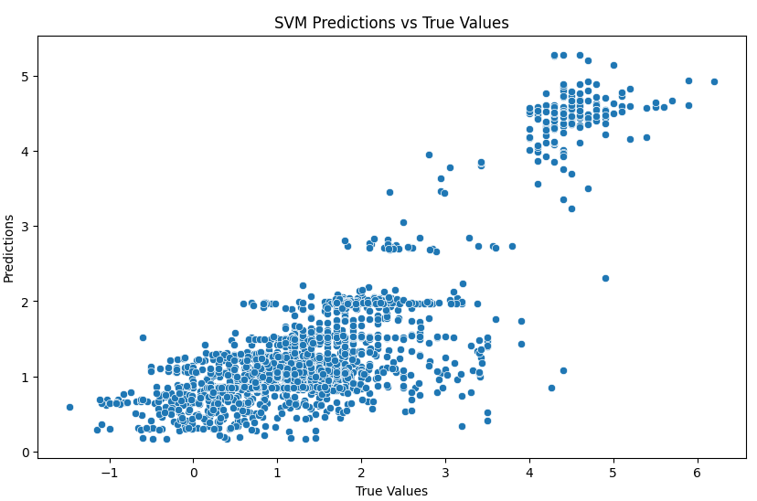
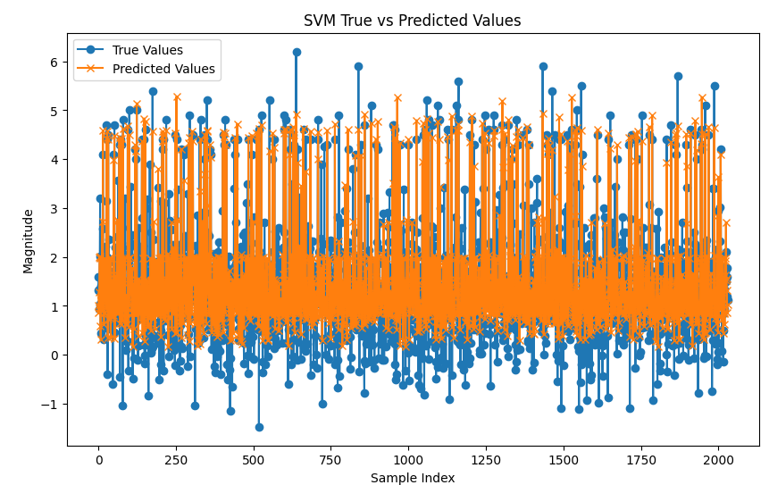
Support Vector Machine
Objective: Predict continuous earthquake magnitudes.
Model Choice: SVM known for robustness and effectiveness in high-dimensional spaces.
Training and Evaluation:
Utilized kernel functions to handle non-linear relationships.
Trained on data to capture complex patterns.
Evaluated using Mean Squared Error (MSE) and R² score for accuracy assessment.
Outcome: Provided accurate predictions by capturing intricate data patterns.

Slide 19
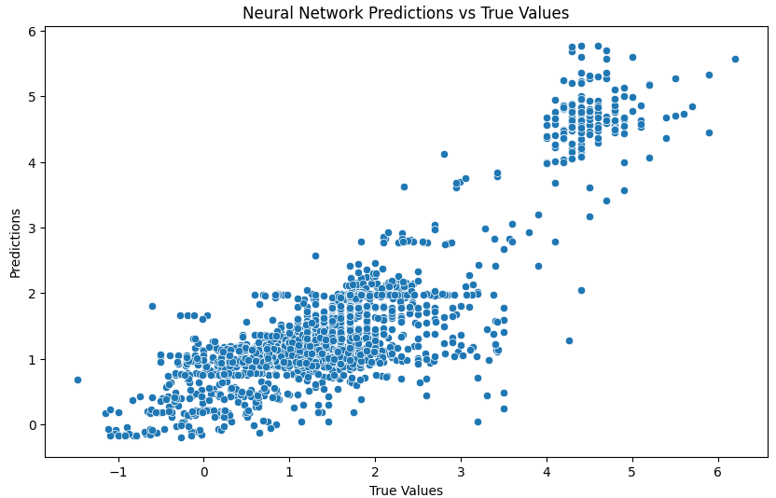
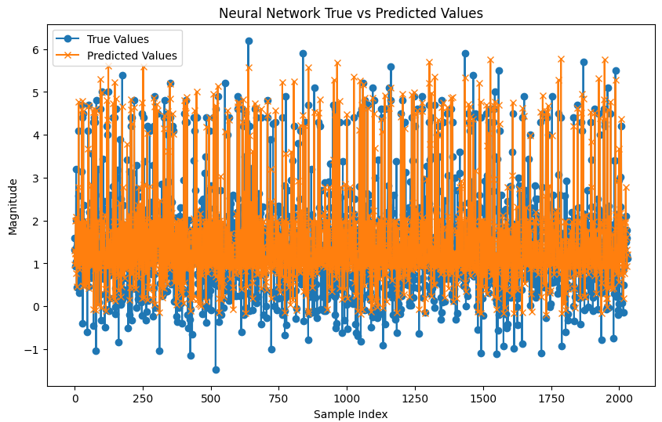
Neural Network
Framework: Built using TensorFlow and Keras.
Architecture: Multiple dense layers with ReLU activation.
Optimization: Adam optimizer used for training.
Training: Iterative learning over epochs to model complex, non-linear relationships.
Evaluation: Assessments via Mean Squared Error (MSE) and R² score.
Advantages: Capable of capturing intricate data patterns and interactions.
Outcome: Visualized predictions compared to true values, highlighting performance and areas for enhancement.

Slide 20
05
MODEL COMPARISON

Slide 21
Evaluation Metrics: Mean Squared Error (MSE) and R² Score used to assess performance.

Slide 22

Best Model: Random Forest
Key Strength:
Balances low Mean Squared Error (MSE) and high R² Score.
Performance Highlighted:
Stands out among models in predicting earthquake magnitudes.

Slide 23
CONCLUSION

Slide 24
Conclusion
This project demonstrates the application of various machine learning models to predict earthquake magnitudes using USGS data. Complex models like Neural Networks, Random Forest, and Gradient Boosting outperform simpler ones such as Logistic Regression and Decision Tree. The project emphasizes the importance of data preprocessing, model selection, and thorough evaluation.
Future work includes exploring additional features, advanced neural network architectures, hyperparameter tuning, and incorporating domain-specific knowledge and real-time data. The team also plans to implement deployment strategies for real-world application.

